Slide 1

TechAndMech
A Blogging Website
Submitted By –
Aditya Pratap Singh {181500045}
Ayush Singhal {181500181}
Yashvardhan {181500833}
Submitted To –
Akash Kumar Choudhary
Technical Trainer

Slide 2
WHY DO WE NEED THIS WEBSITE
The idea of this project arose on our mind when one of us was searching for a decent smartphone to buy but was not aware of which features to focus on and which smartphone will be best under his budget, also as technology enthusiasts, we always have the curiosity to learn more about what new advancements are being made in the market nowadays and which are upcoming advancements in technology but when we searched on the internet we didn’t found a perfect stop according to our needs. So we decided to create a website where you can find both of the things without the need to wander on the internet to find a place for your expectations.

Slide 3
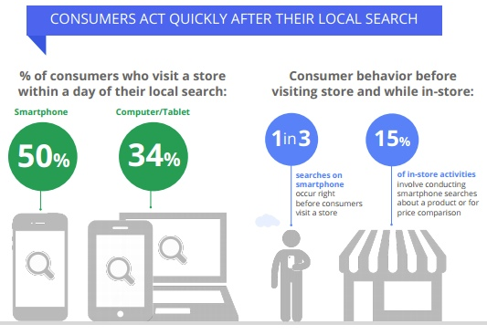
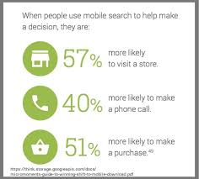
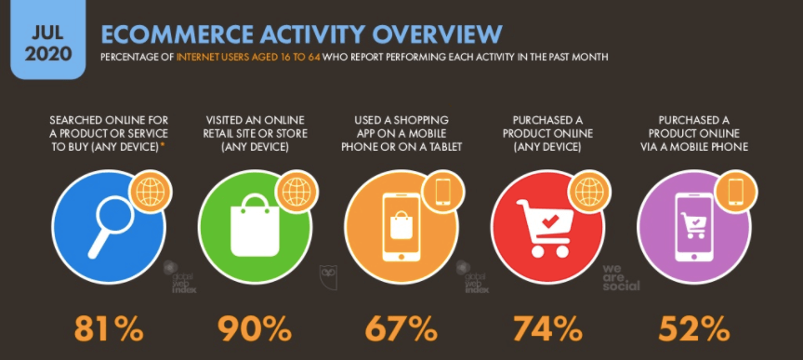

Slide 4
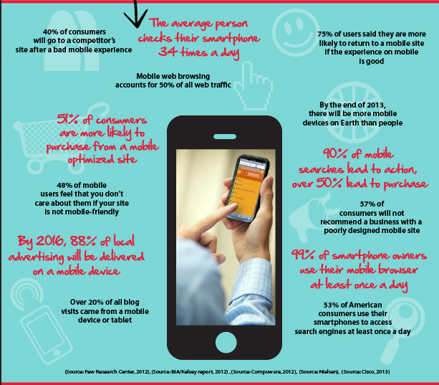

Slide 5
As we can see from the above images and data that mostly people visits to online sites to know about appropriate smartphone according to their needs before purchasing the smartphone. So, our project will provide another platform to people with better clarity and information regarding all smartphones which makes easier for the user to decide or choose the smartphone.
This will help in :
Providing appropriate information with better clarity.
Reduced time for users in searching about smartphone visiting several websites.
Providing users new and easy to use platform.

Slide 6
This Project is divided in three parts :
Home Page
Display Page, which displays all smartphones
Specs Page of each Smartphone.

Slide 7
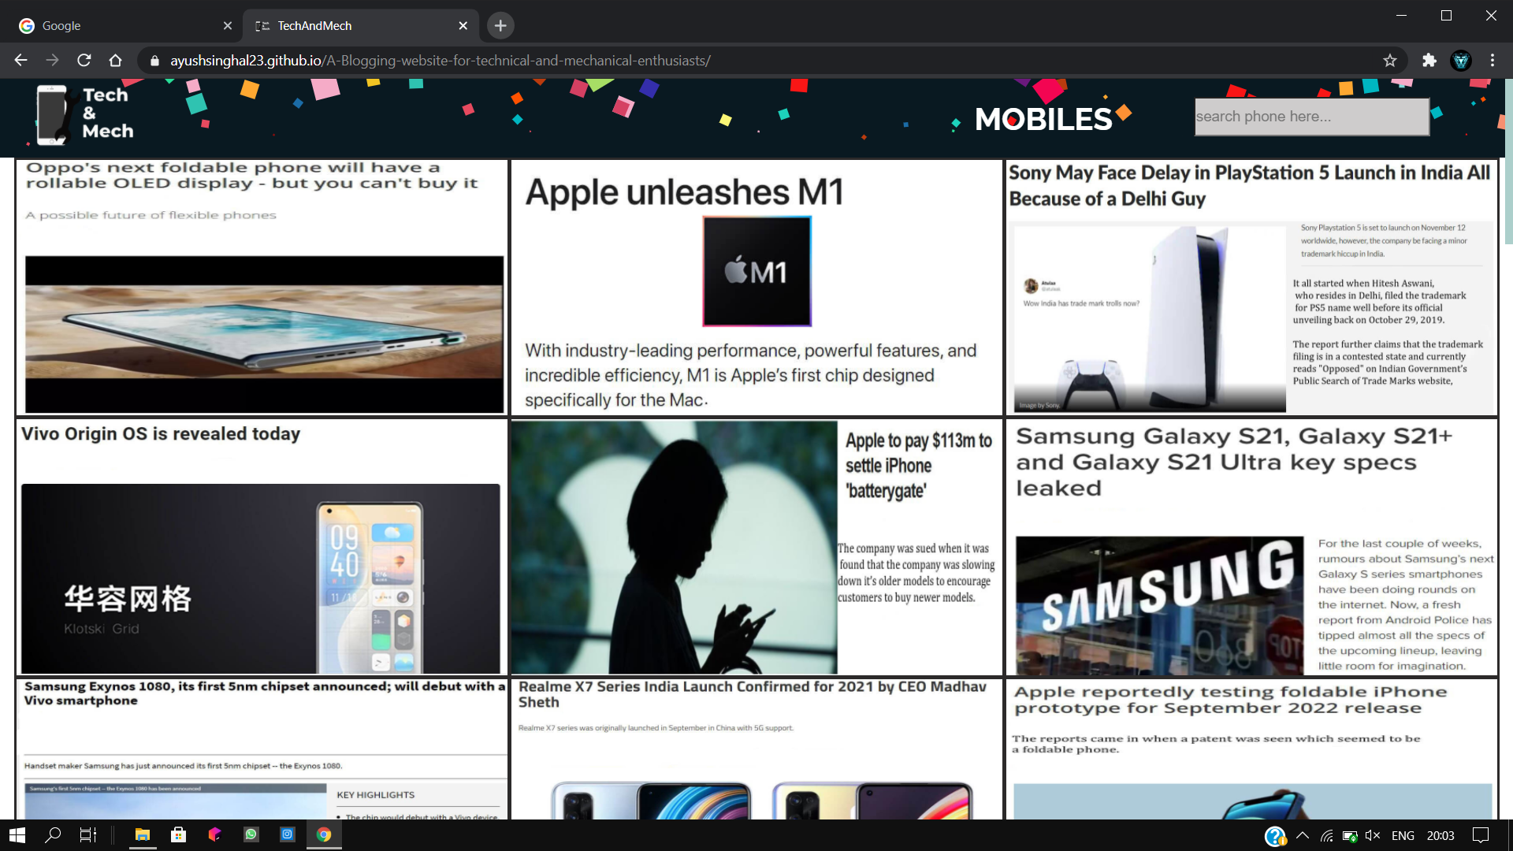
Home Page (Index.html)
Nav Bar
Search Box
News

Slide 8
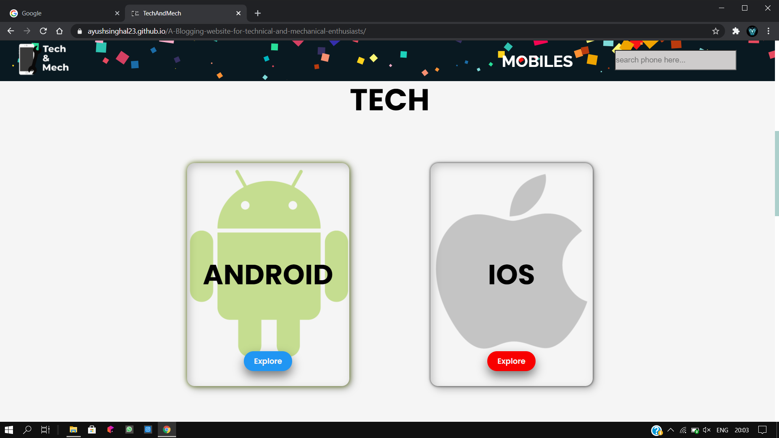
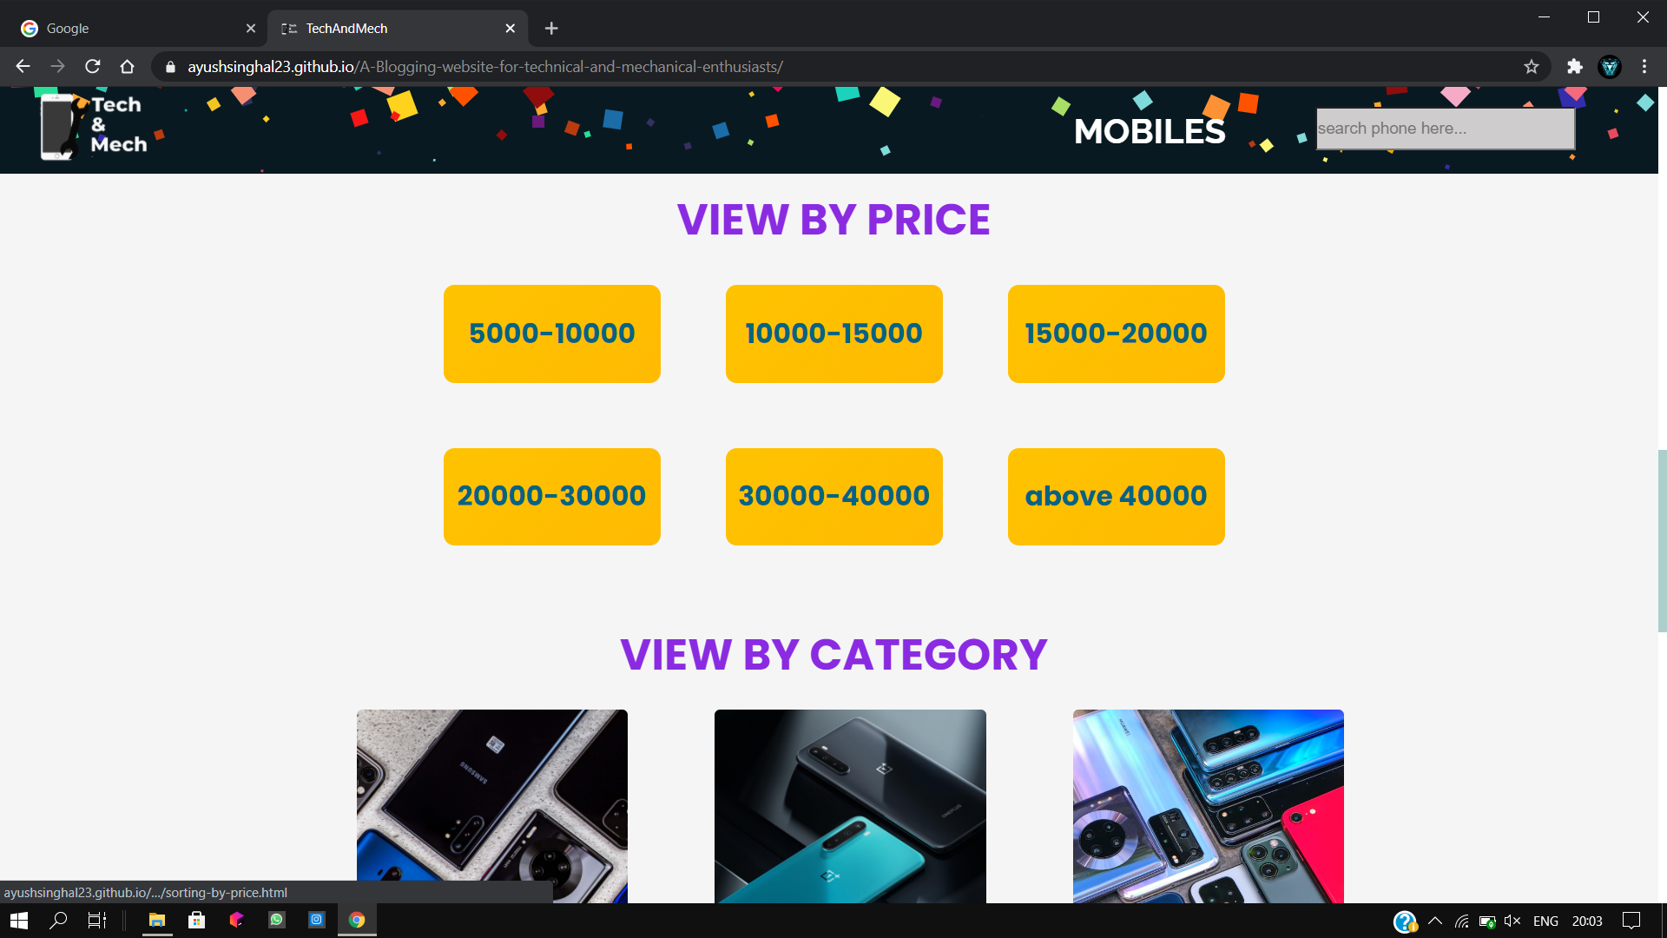
View by OS
View by Price
&
View by Category

Slide 9
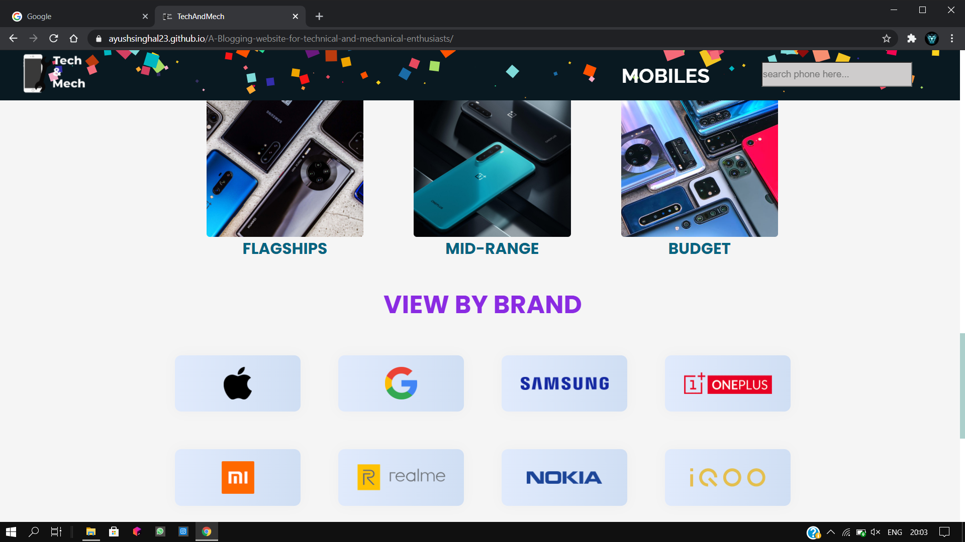
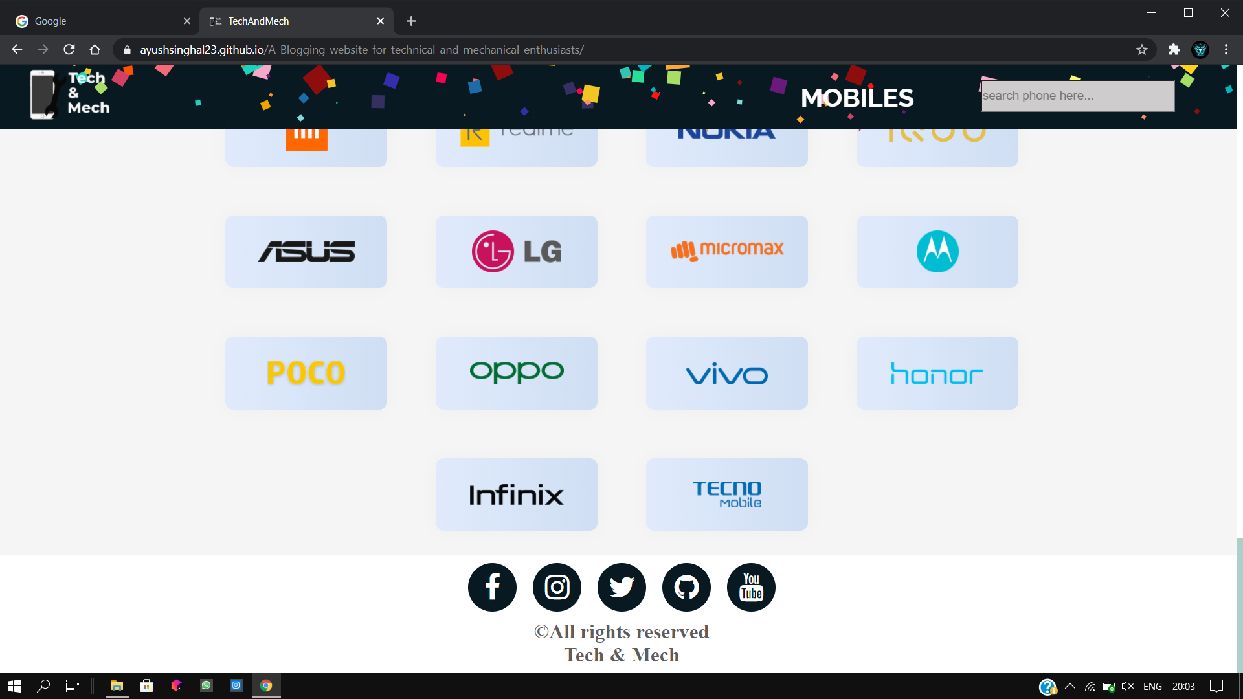
View by Category
&
View by Brands
Brands
&
Social Links

Slide 10
Home Page (cont.…)
This is our homepage. It contains :
Nav Bar : It contains ‘Mobiles’ option and Search Box (for searching specific smartphone).
Grid : It contains latest and trending news in market.
Cards : There are three types of cards we used –
View By OS : For viewing smartphones according to OS they have.
View By Price : For viewing smartphones according to Price range they fell under.
View By Category : For viewing smartphones according to Category they belongs to.
View By Brands : For viewing smartphones according to brands.
Social Links : Links of different social media platforms to connect with us.

Slide 11
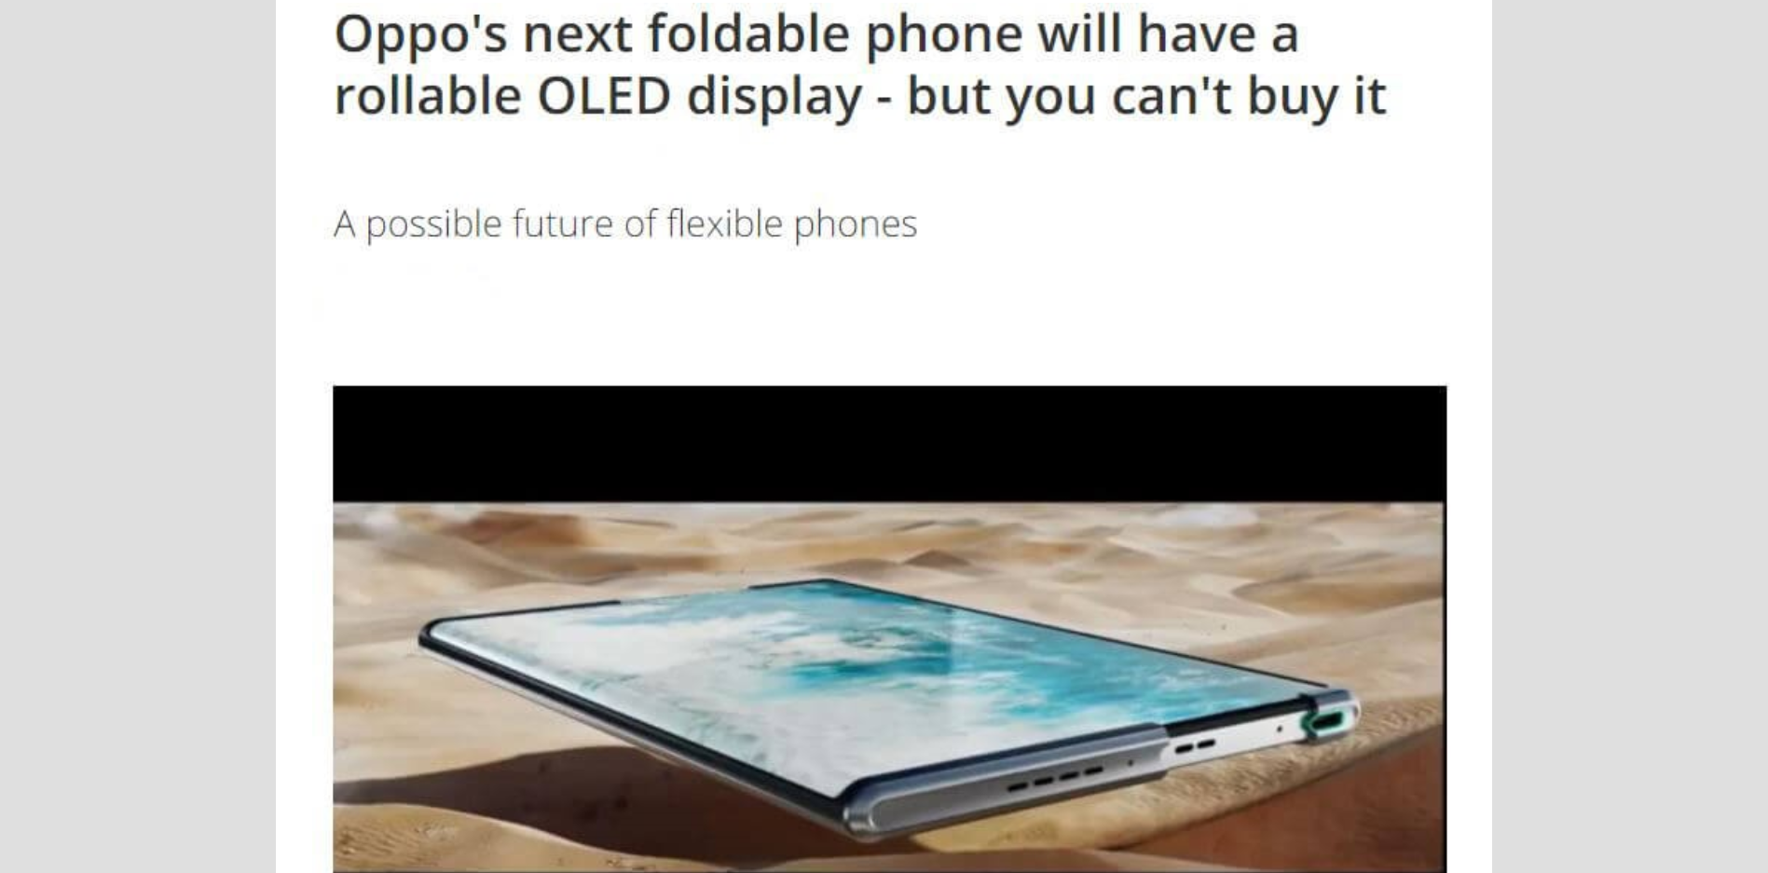
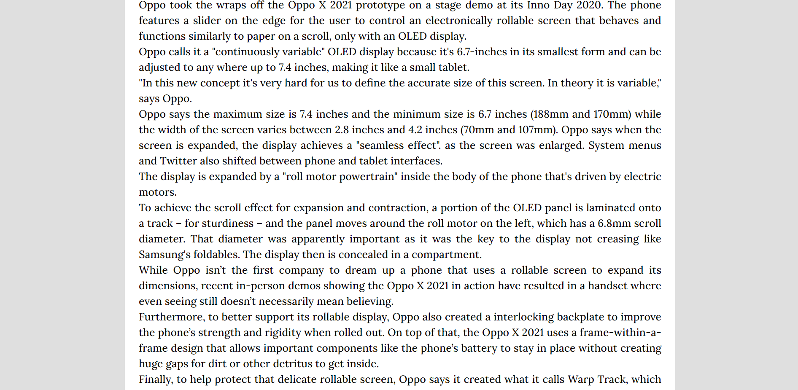
News
News displayed in this format

Slide 12
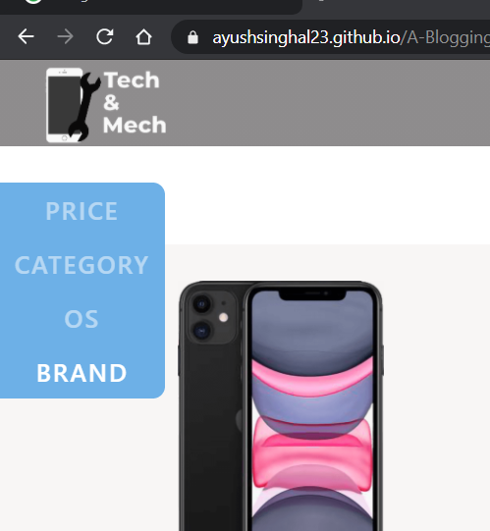
Display Page
CAROUSEL

Slide 13
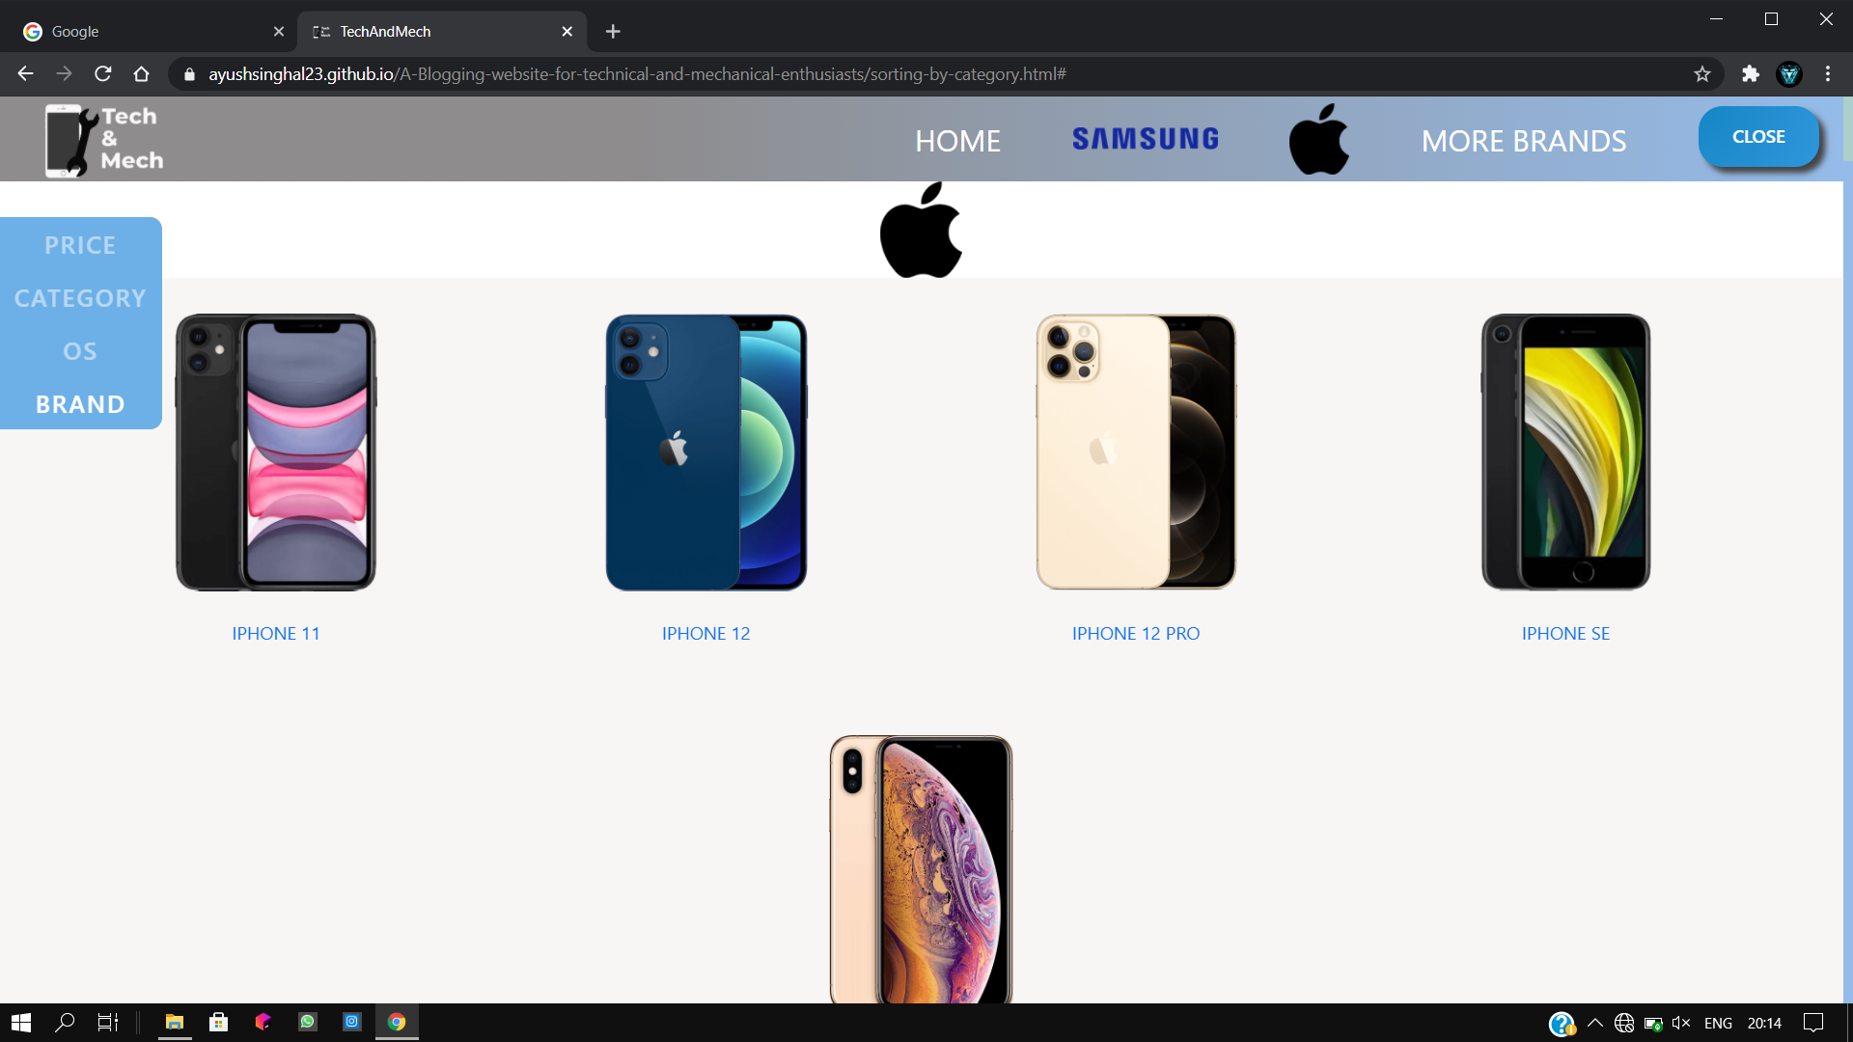
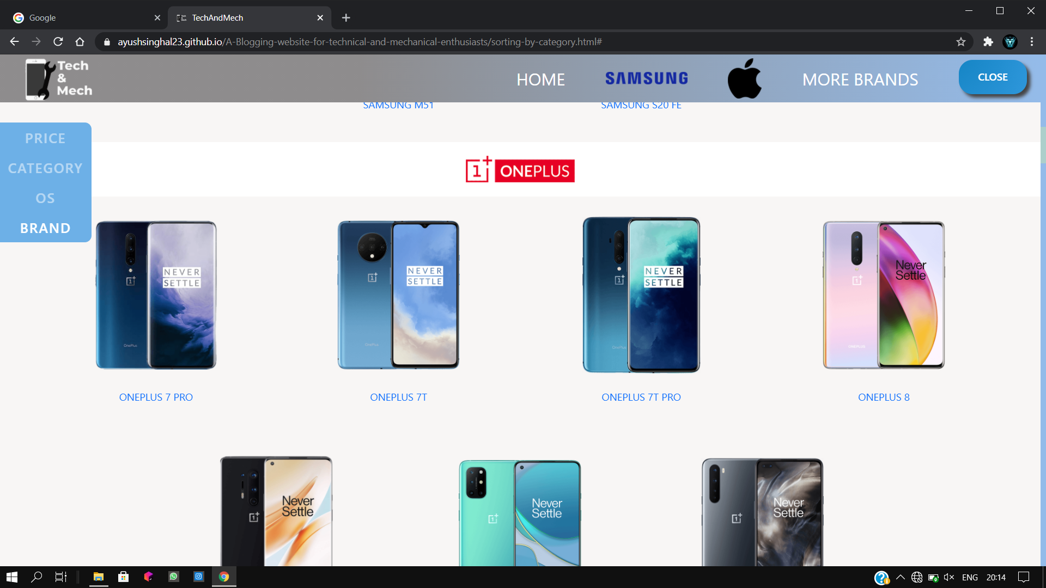
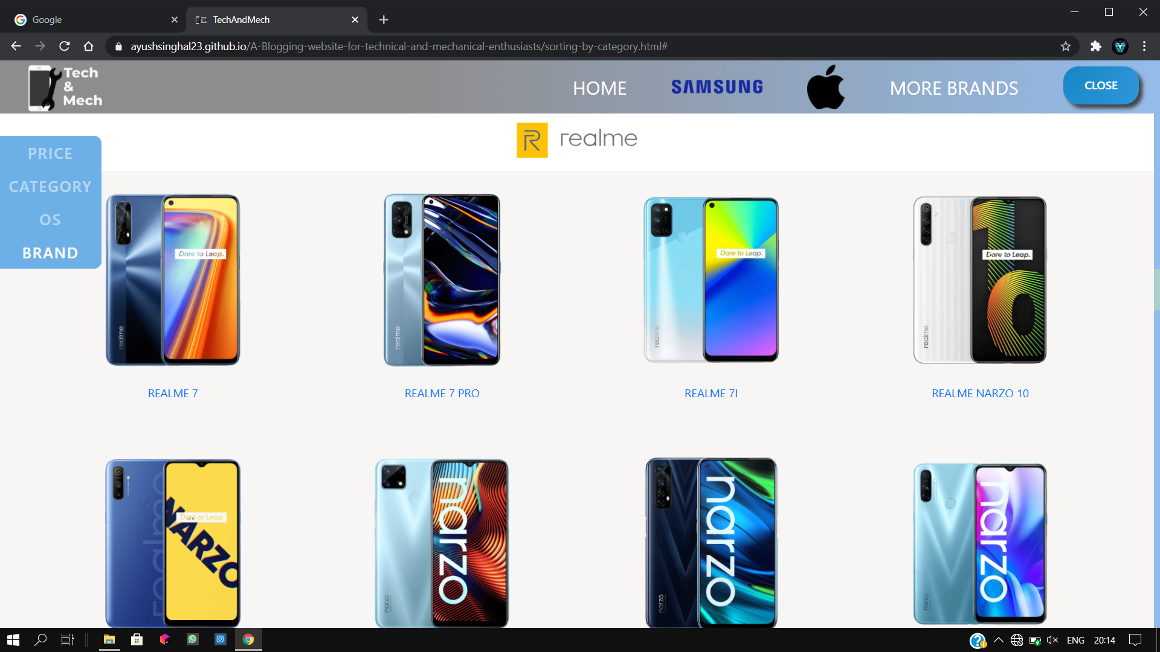
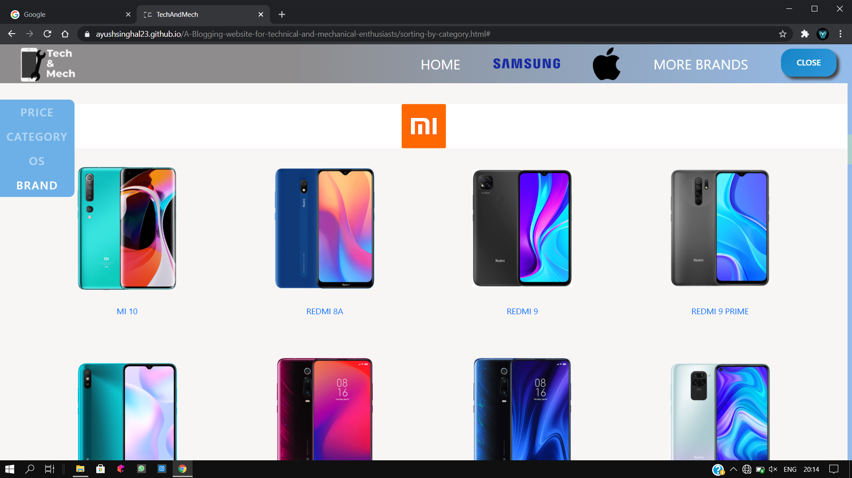
B
R
A
N
D
S
B R
N D S

Slide 14
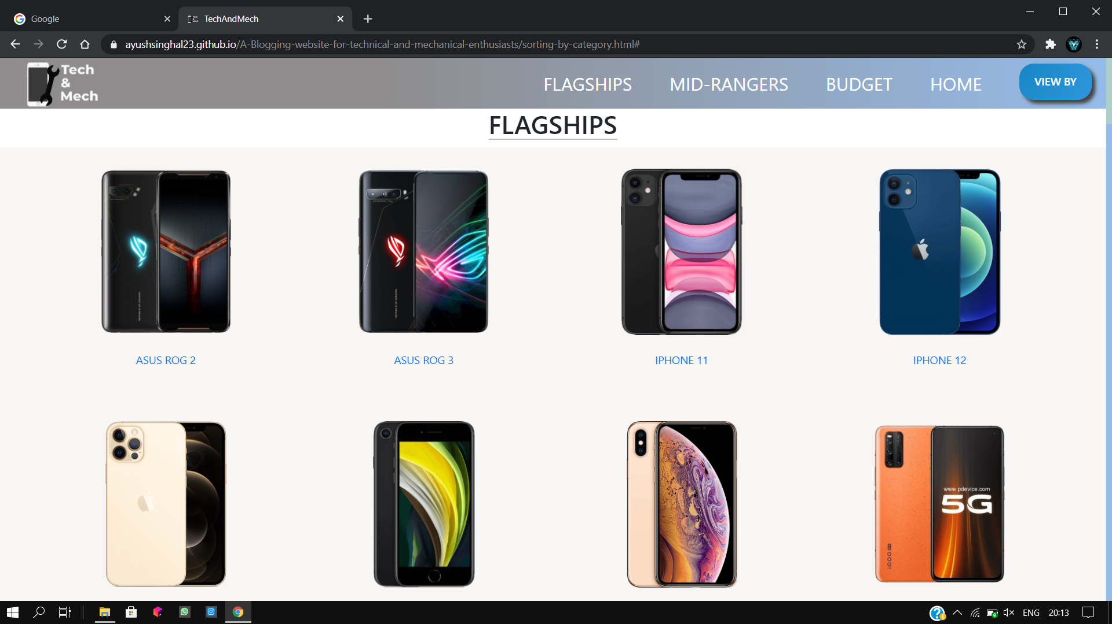
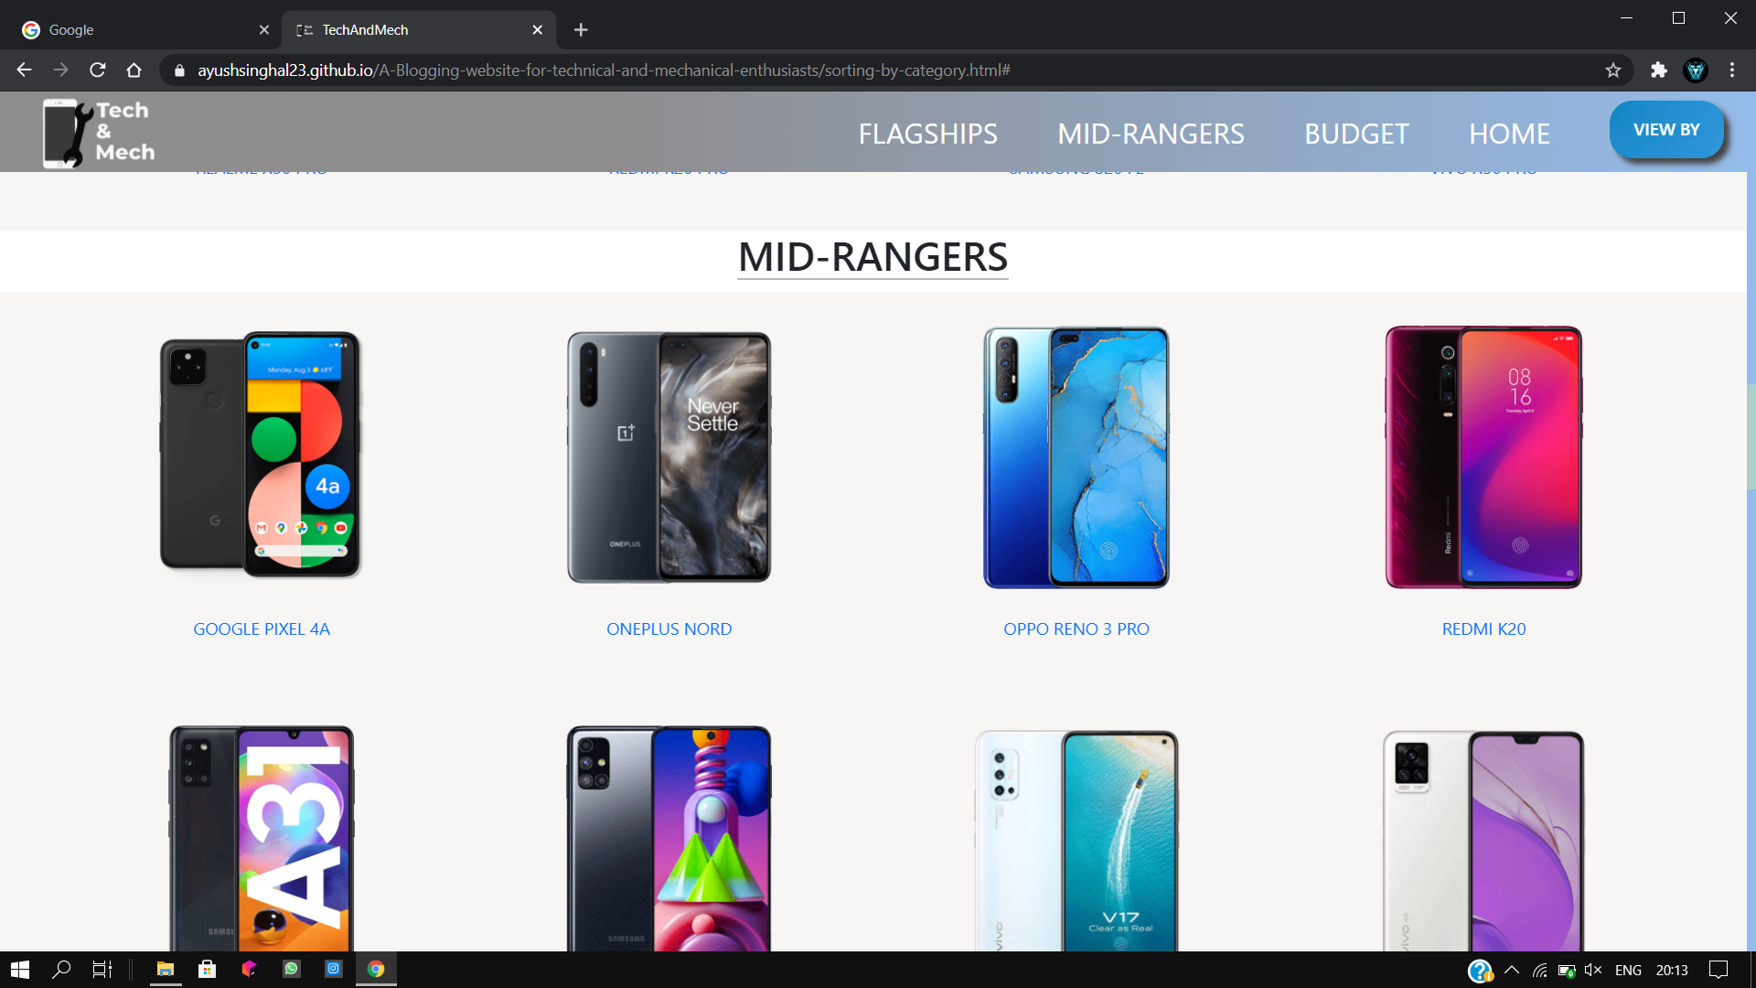
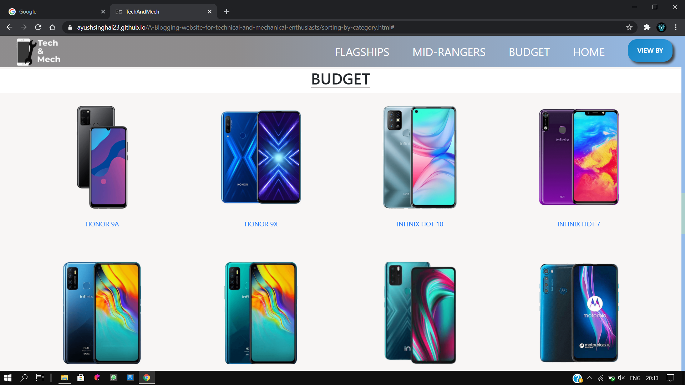
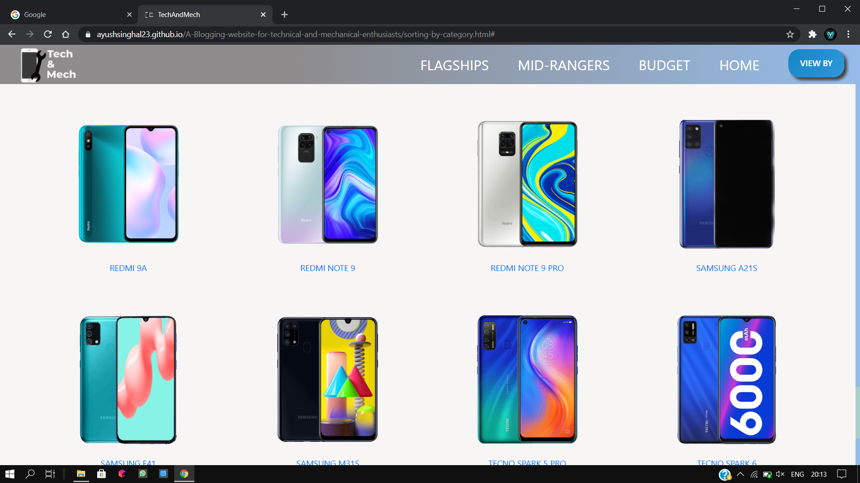
CATEGORY
C A T
G O R Y

Slide 15
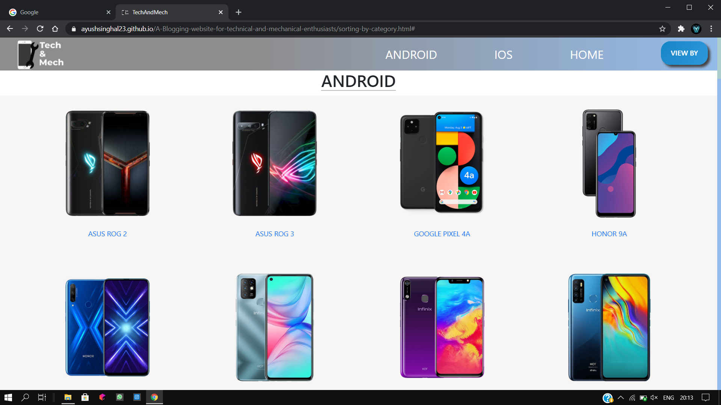
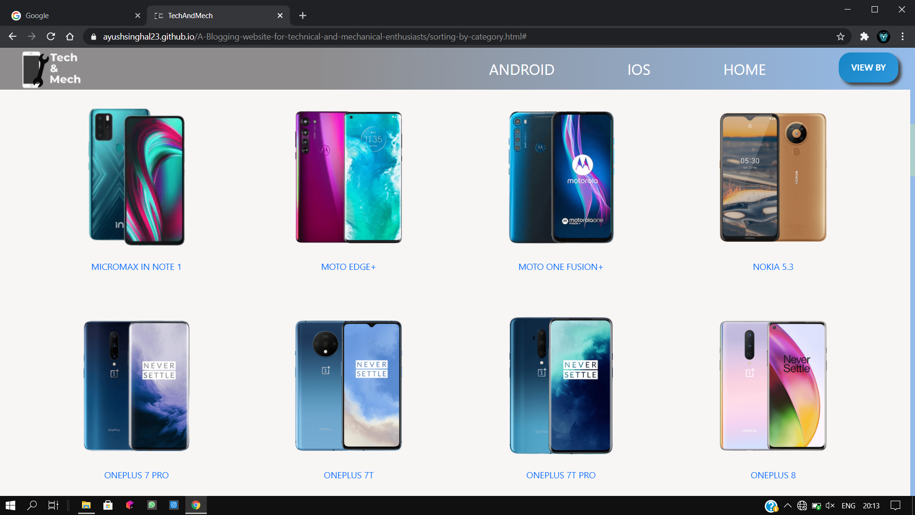
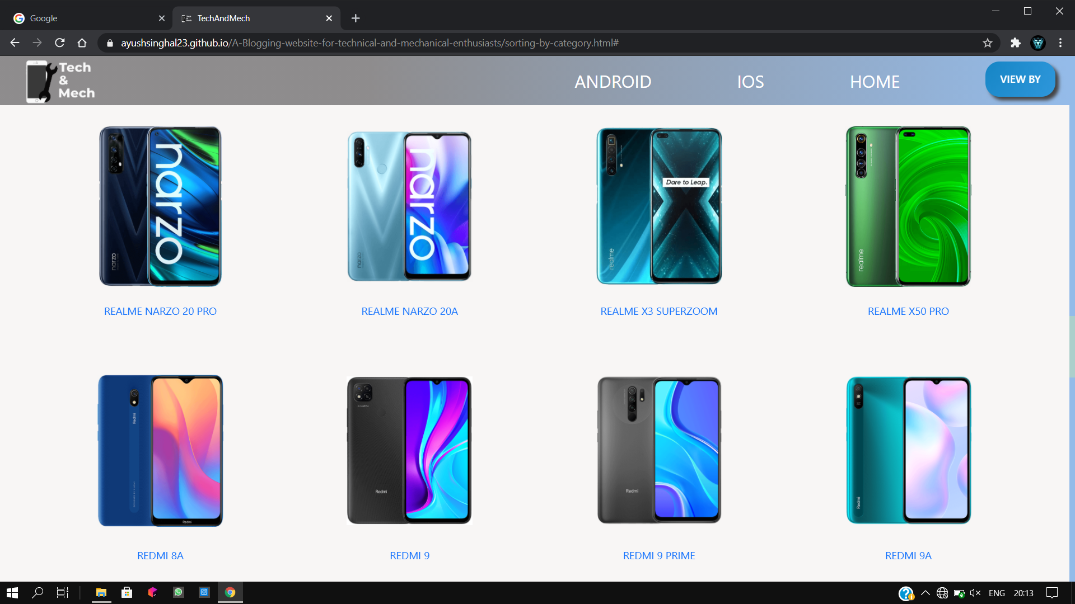
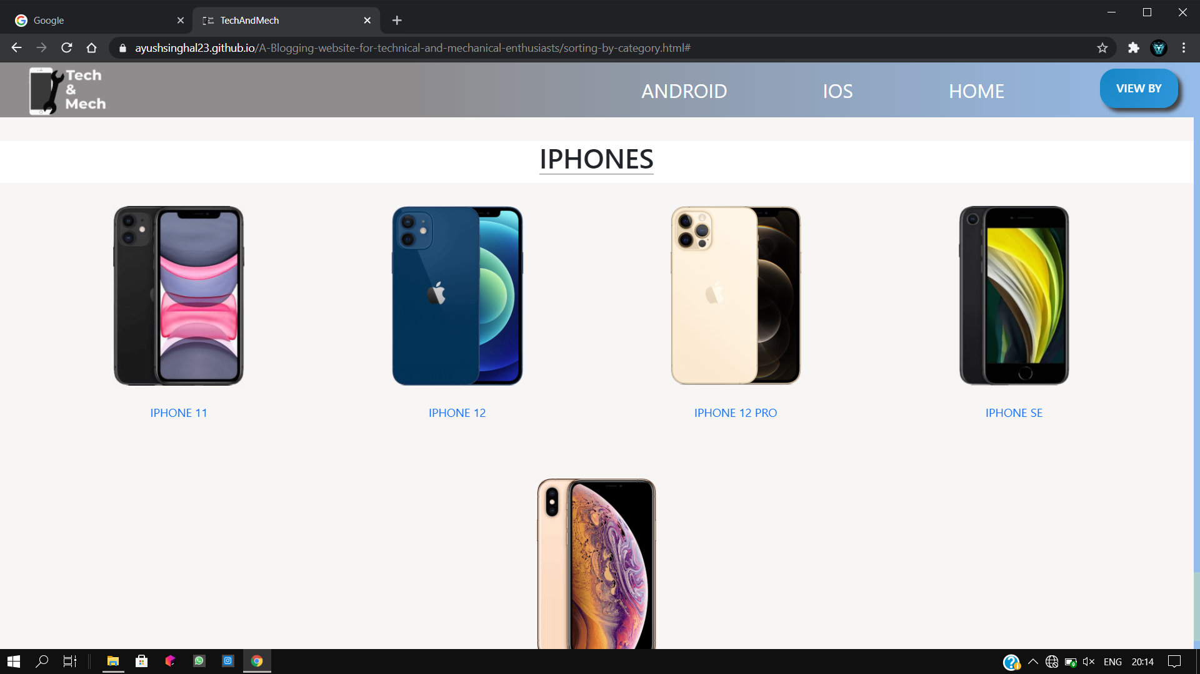
OPERAT INGSYSTEM
O P E R A T I
G S Y S T E M

Slide 16
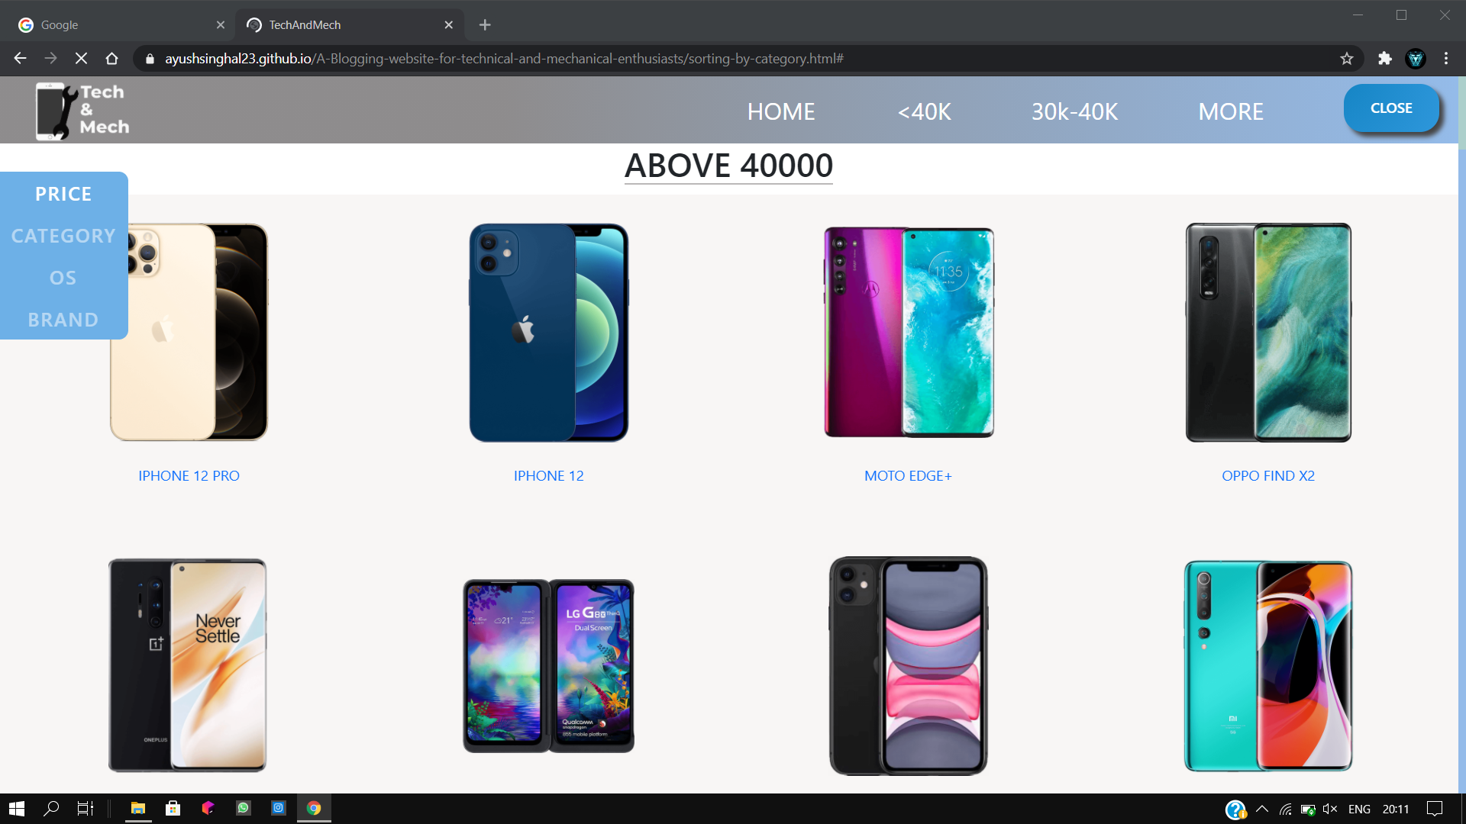
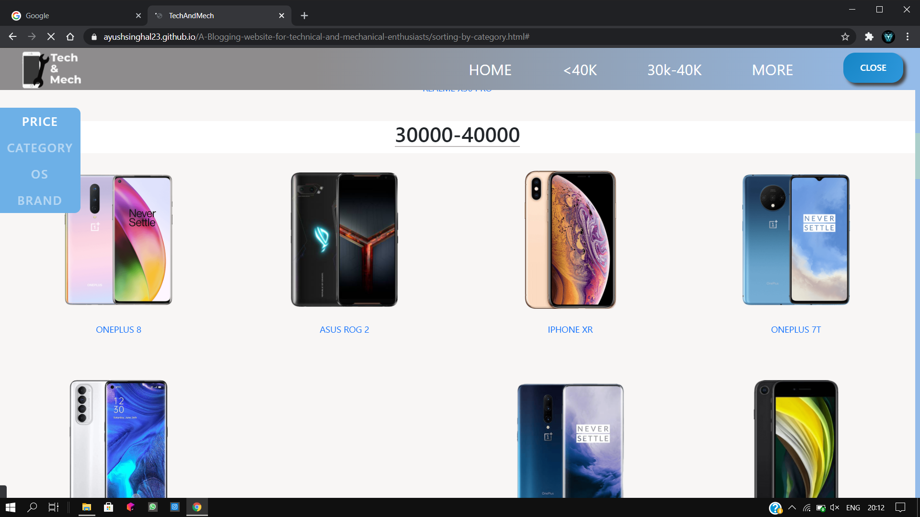
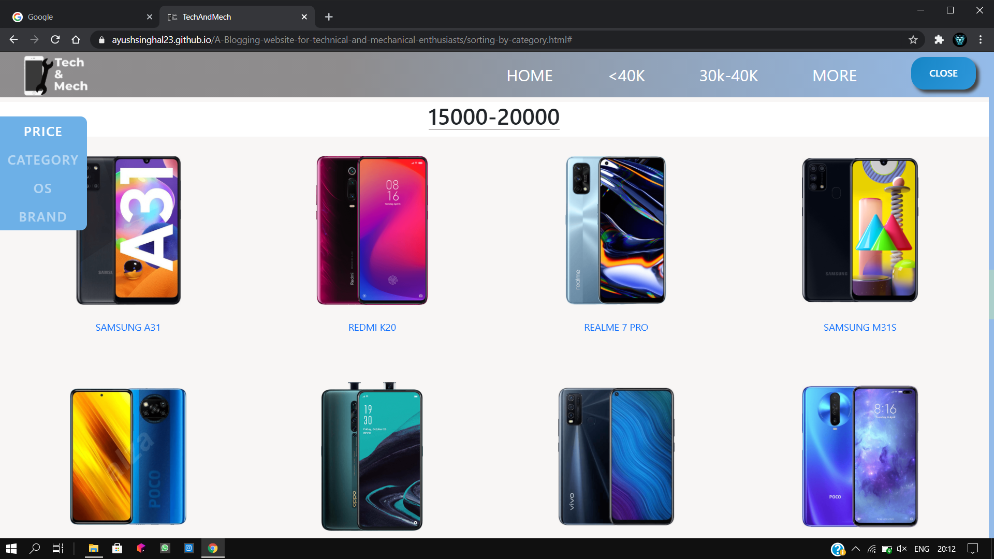
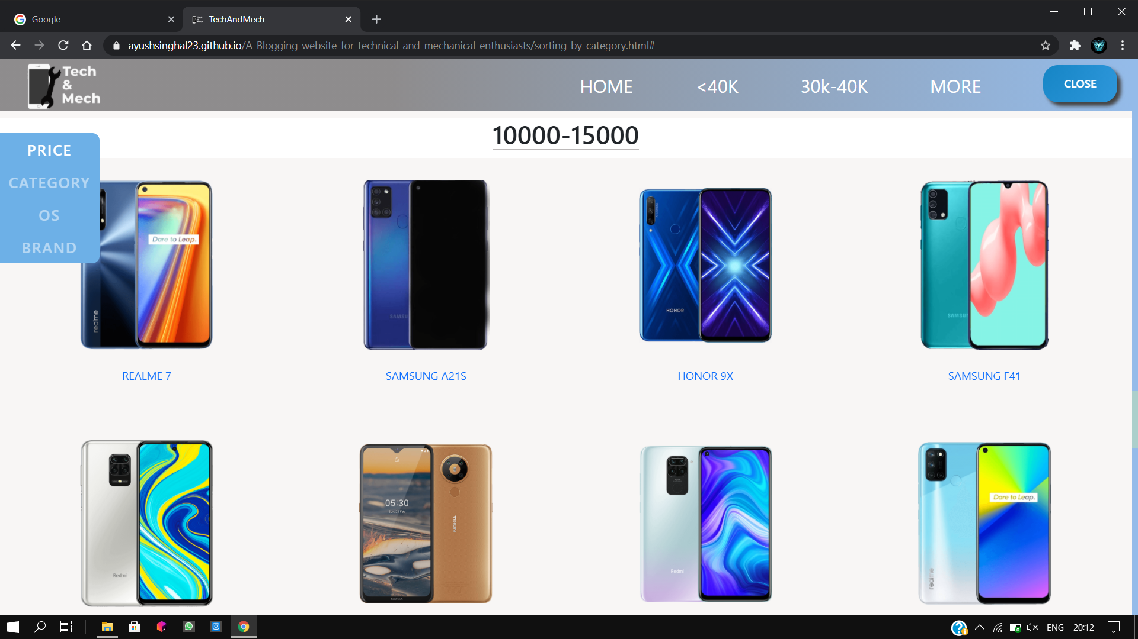
PRICE
P R
C E

Slide 17
Display Page (cont.)
This page displays all the smartphones in four categories :
Brands (Apple, Samsung, Xiaomi, Realme, Oppo, etc.)
Prices (40000-30000, 30000-20000, etc.)
OS (Android, iOS)
Category (Flagships, Mid-Range, Budget)
To navigate each category, we develop a Carousel using which users can navigate to all four categories smoothly.

Slide 18
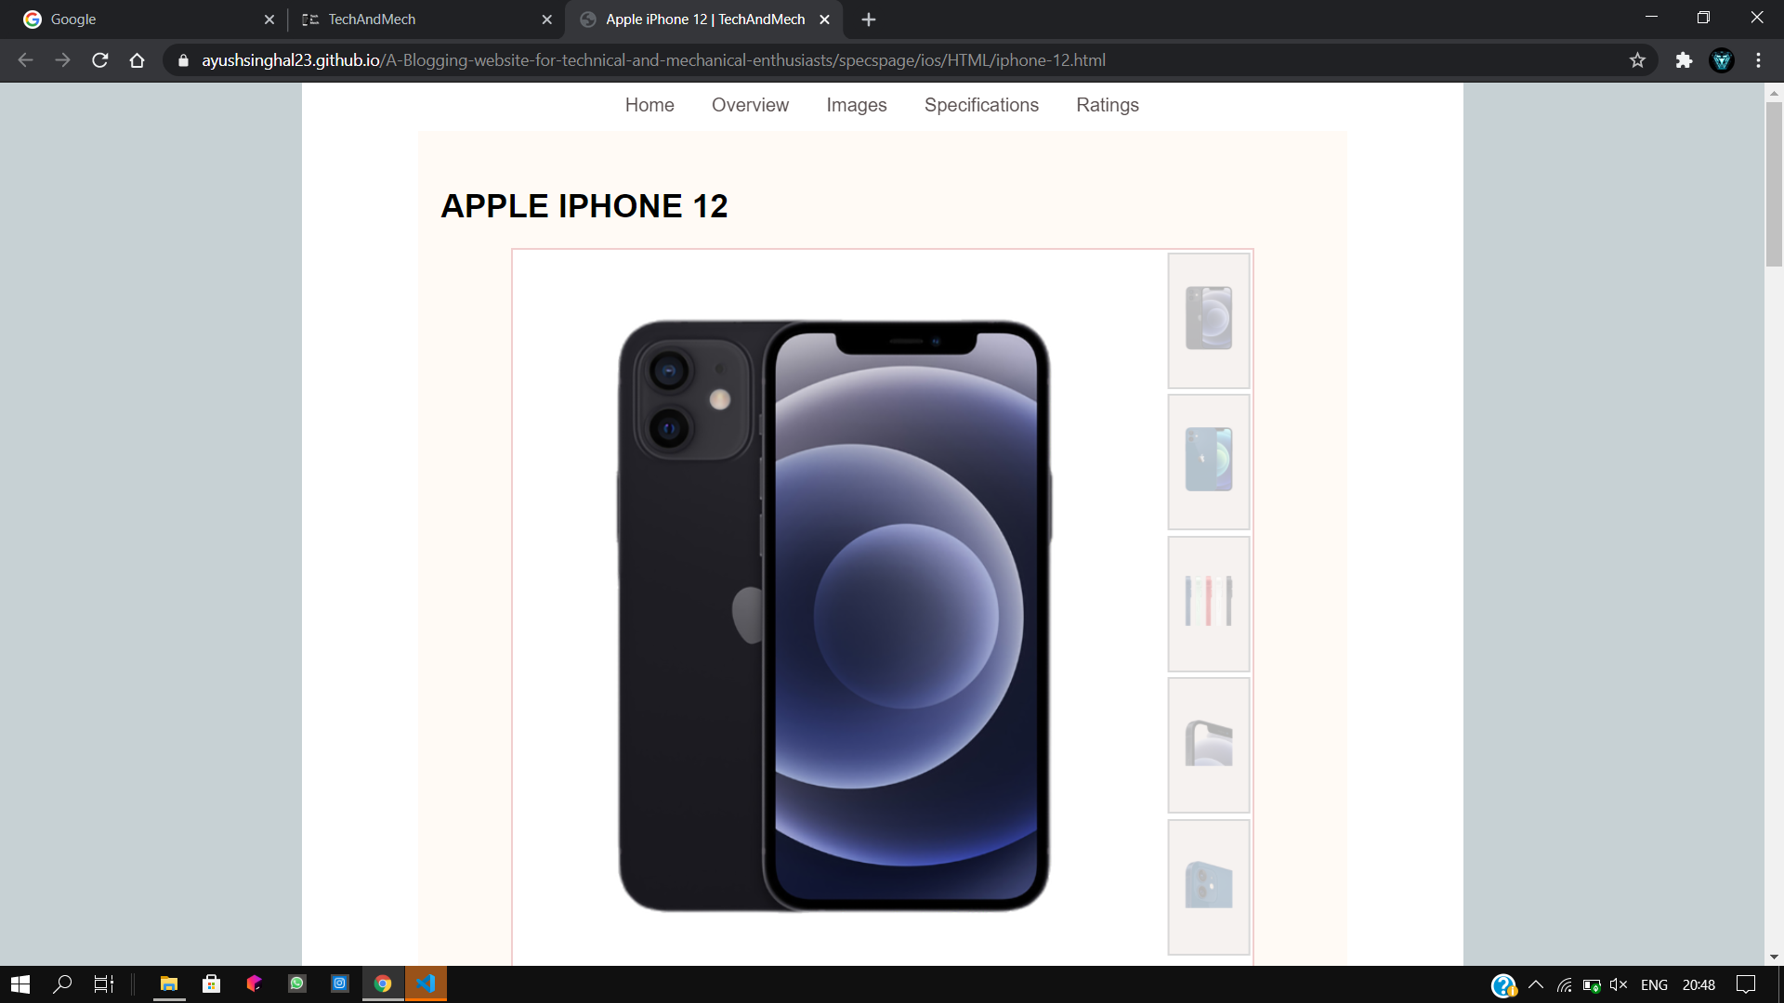
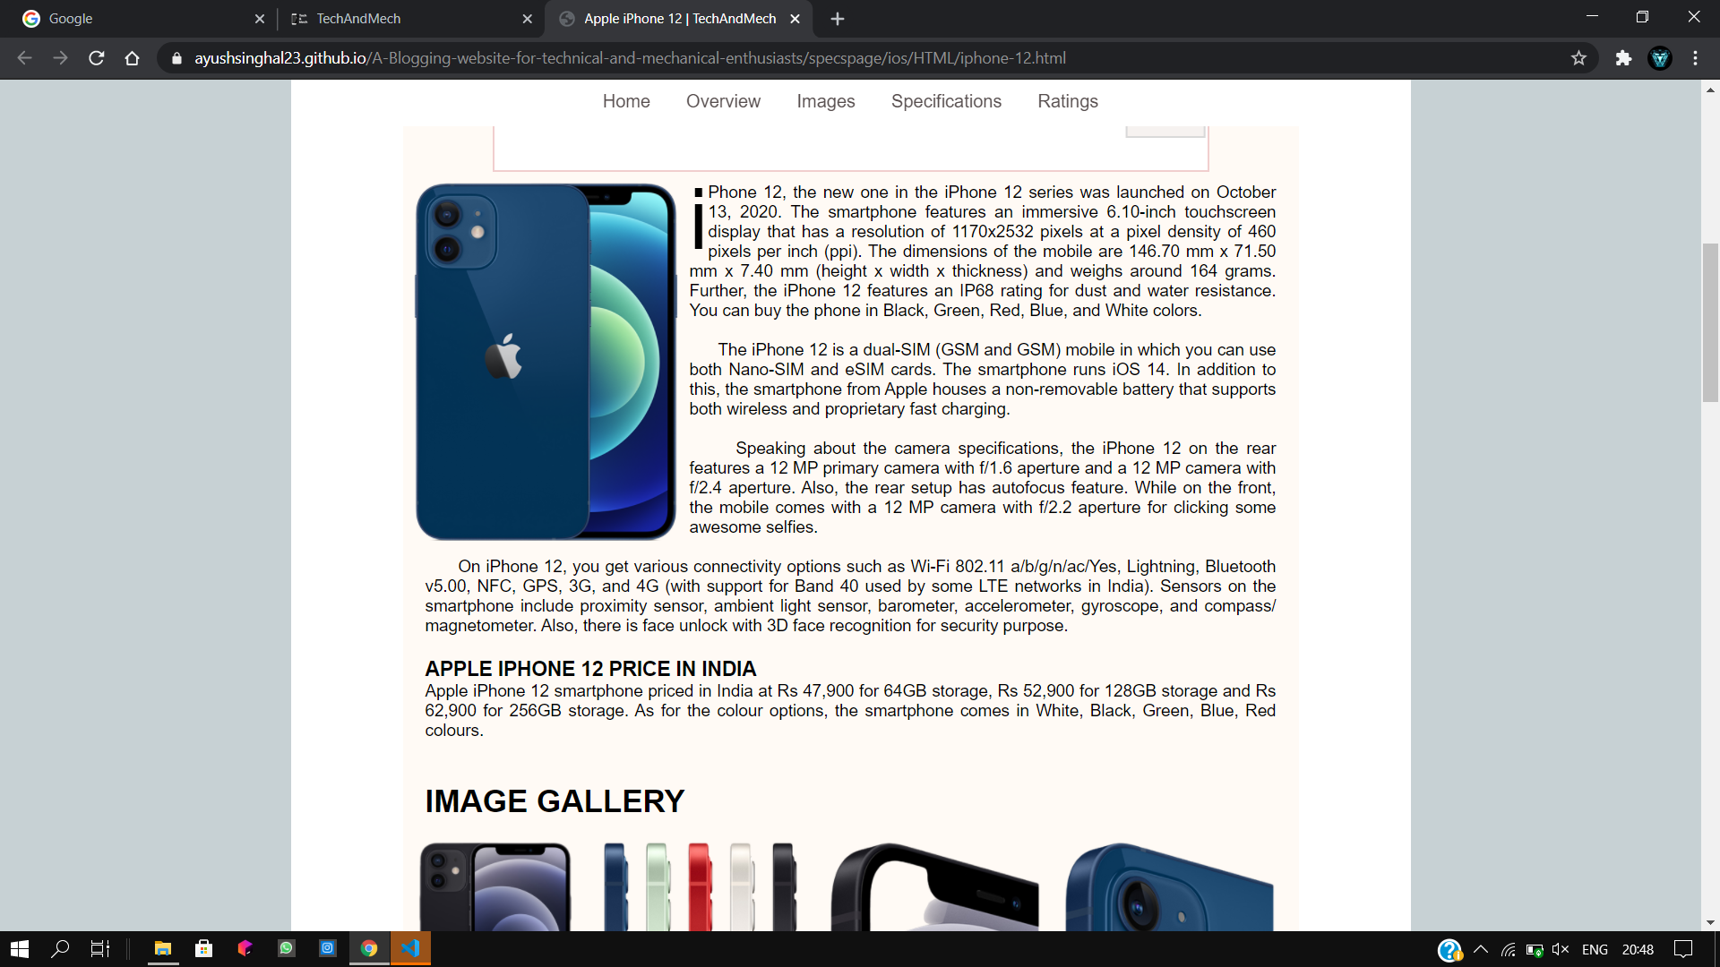
Specs Page
Nav Bar
Image Slider
Overview

Slide 19
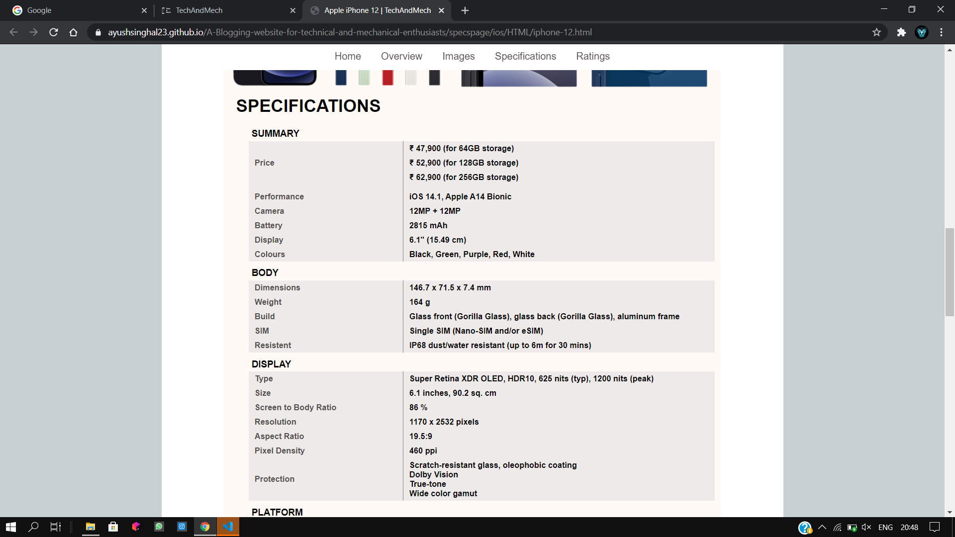
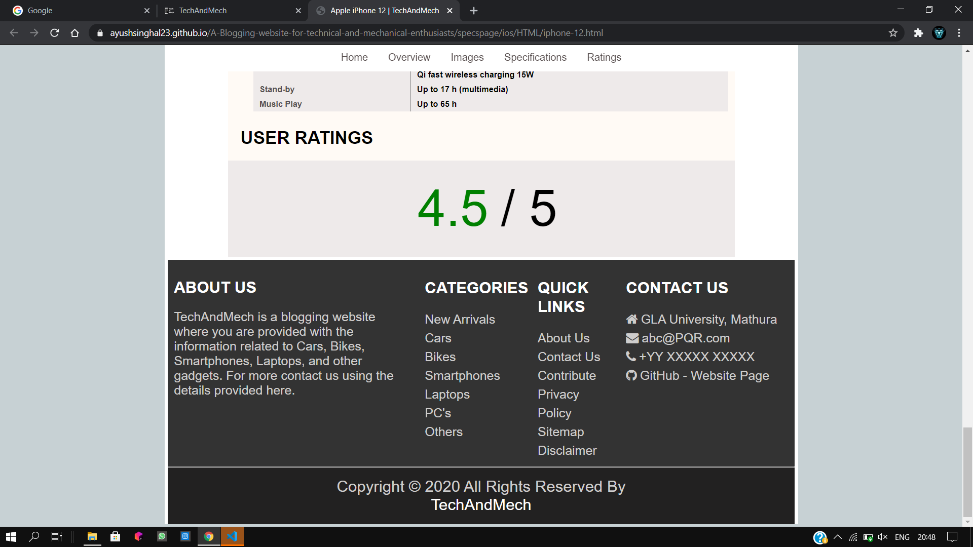
Specifications
Ratings
Footer

Slide 20
Specs Page (cont.)
In Specs Page of each smartphone, we displayed following things :
Nav Bar (To navigate within the page)
Image Slider (To view images in Zoom In mode)
Overview (Summary of the smartphone)
Image Gallery (Contains all images related to smartphone)
Specifications (Contains all specs of the smartphone)
Ratings
Footer

Slide 21
THANK YOU

